Slide 1

MaintControl - Maintenance Project
Students’ names: Nave Shimoni (207382987), Lior Fridman (206798902),
Reuven Bar (316043652), Matan Avital (204597082)
Moderators' names: Tal Gumai, Mark Israel

Slide 2
Table of Contents
Goal……………………………………………………………………………..………….3
Main processes…………………………………………………………………….4-5
Main modules…………………………………………………………………….6-16
Requirements from the specification document……………………17
Main products-Screenshots……………………………………………..18-28
Unexpected problems…………………………………………………………..29
Coping and Solving…………………………………………………………..30-31
Conclusions for further development……………………………………32

Slide 3
Goal
Creating a generic WEB-based system, which provides a solution to the problem of supervision and control of the maintenance carried out by different companies in different locations in the country, thus optimizing the daily work of the maintenance workers.

Slide 4
Main processes
Task Management: Maintenance workers receive a list of daily missions in a specific order. They can view and prioritize tasks based on their arrival and location. The app provides details about each task, including subtasks, maintenance history, comments, and photos.
Task Execution: Maintenance workers navigate to the location of each mission using location services. They can mark subtasks as completed or encounter issues and add comments explaining the problem. Upon finishing the work at a location, the app determines the mission's status based on completed subtasks.‏
Mission Completion: If all subtasks are completed, the mission is marked as finished, and a new maintenance date is added to the list. If any subtasks remain incomplete, the mission is sent back to the manager for further action.‏

Slide 5
Main processes
Manager Functions: Managers can view all open missions and assign them to maintenance workers based on availability, location, and skills. They review and address failed missions, reassigning them as necessary. Managers can update and maintain a knowledge page containing mission details, subtasks, required tools, and user guides.‏
Administrator Functions: Administrators have permissions to add new users with specific roles (maintenance, manager, administrator). They can delete users from the system and update user permissions as needed.‏

Slide 6
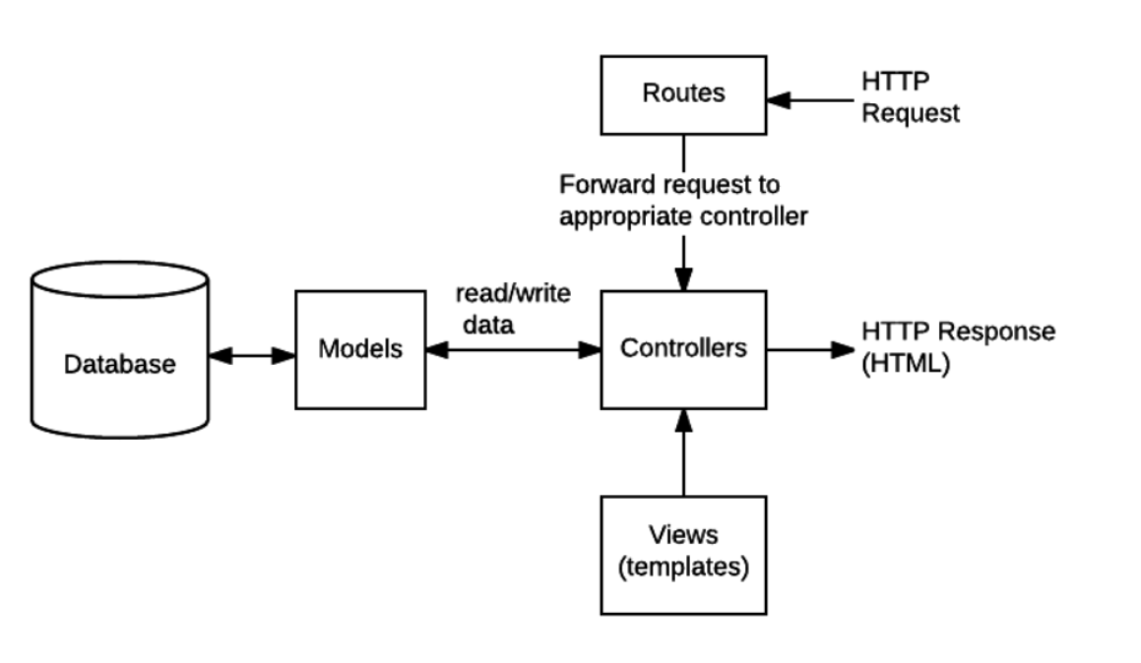
Main modules - Server side
The server side is built on a basic MVC architecture.
The requests reach the appropriate routers.
The routers activate the relevant controllers.
The controllers use the models if necessary and make sure to return an answer to the client.

Slide 7
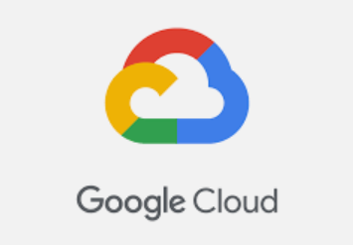

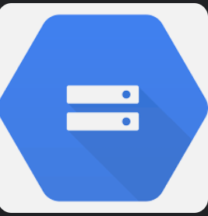
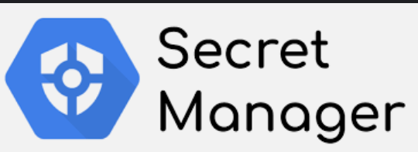
Main modules - Google Cloud Platform
In additiWe used GCP to upload images we created by docker to the cloud run environment
on, we made use of cloud storage with buckets
We used a secret manager to keep sensitive information on the server
We also uploaded a PostgreSQL SQL instance in the cloud

Slide 8
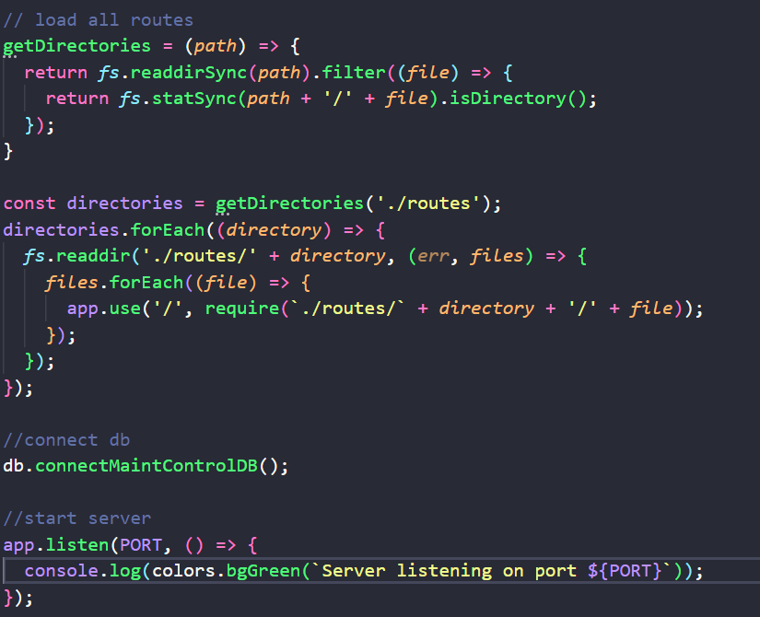
Main modules – Starting the server
When the server goes up, we load the express middleware so that we can make HTTP requests to the server.
Then dynamically load all the routes so that we can call their API.
We set up the DB and connect it to perform various write, delete, and update operations.
Finally, we turn on the server and listen to HTTP requests.

Slide 9
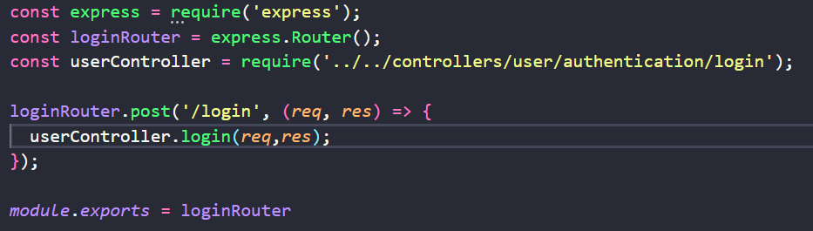
Main modules - Routes
We use routers to receive HTTP requests from a client and run the appropriate controller.
We export the router as express middleware so that it can be accessed via proper HTTP requests.

Slide 10
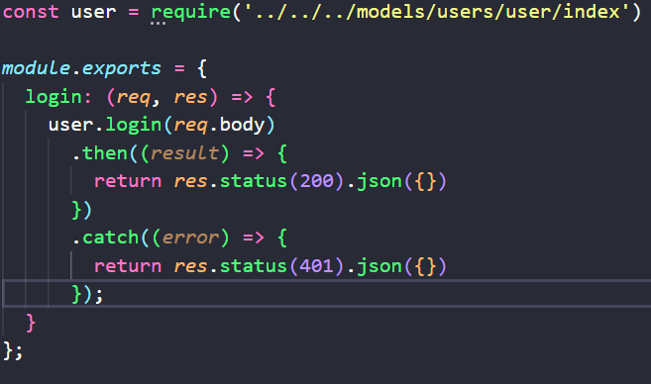
Main modules - Controllers
The controller activates the appropriate models and returns an appropriate response (for example a 200 response if everything is normal, and a 401 response if something is not normal or the user is not authorized to perform the operation, etc.).

Slide 11
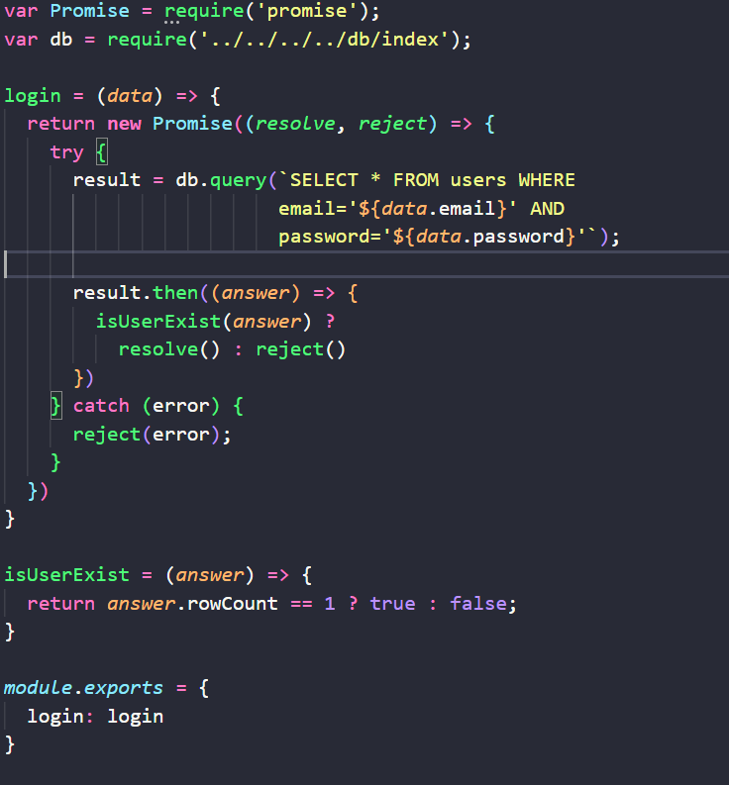
Main modules - Models
The model is responsible for performing the various operations such as writing to the DB, performing email validation and anything functional required in the same HTTP request.

Slide 12
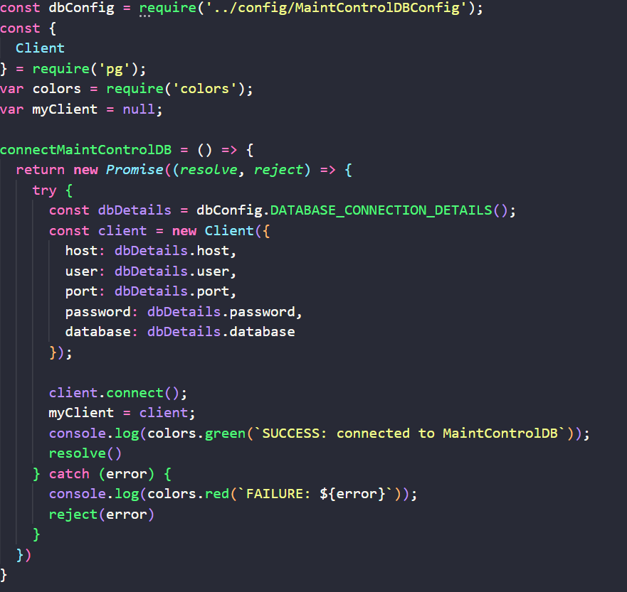
Main modules - DB
There is a file that is responsible for various DB operations that can be used throughout the server.
Operations such as connecting to the DB, various query operations and more.

Slide 13
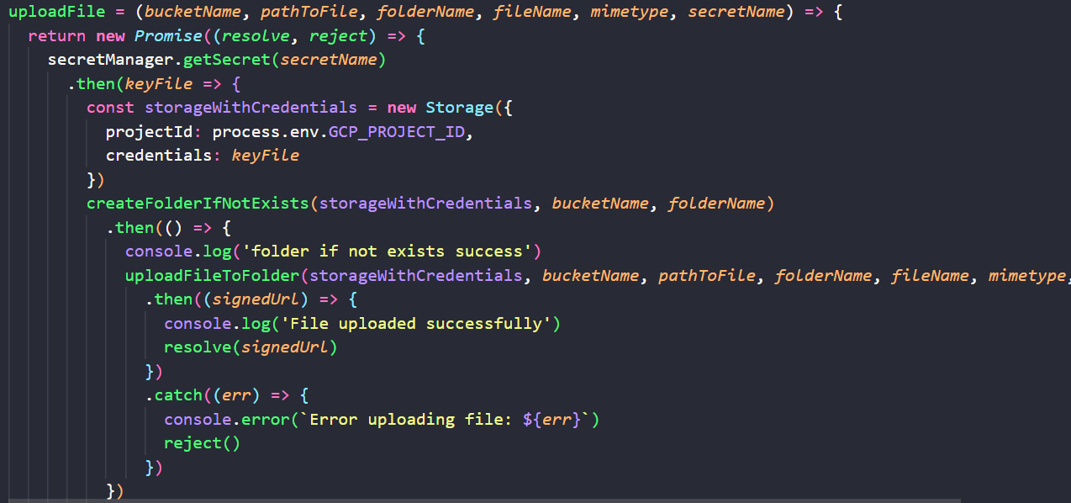
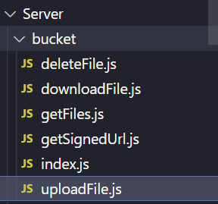
Main modules - Bucket
In order to be able to upload files such as PDF files, WORD files or images, we used buckets in the cloud storage provided in the GCP

Slide 14
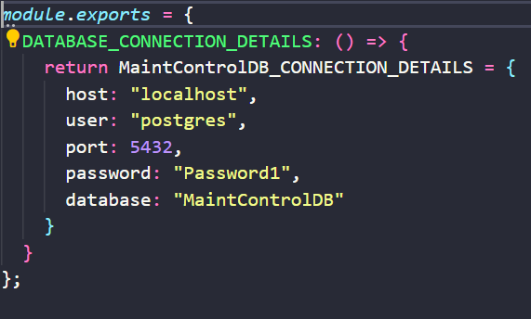
Main modules - Config
There are different config files for the server such as the DB configuration and more.

Slide 15
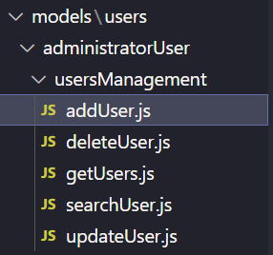
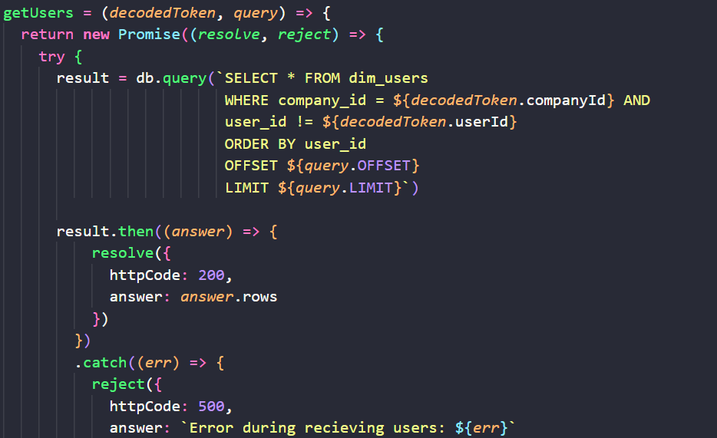
Main modules - User management
We divided the folders in the models in front of the DB according to the type of user (administrator, manager, maintenance)
We have provided an API for adding/deleting/getting/searching/updating users that can only be done by an Administrator user

Slide 16
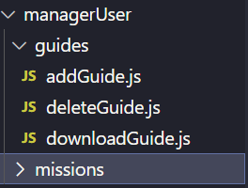
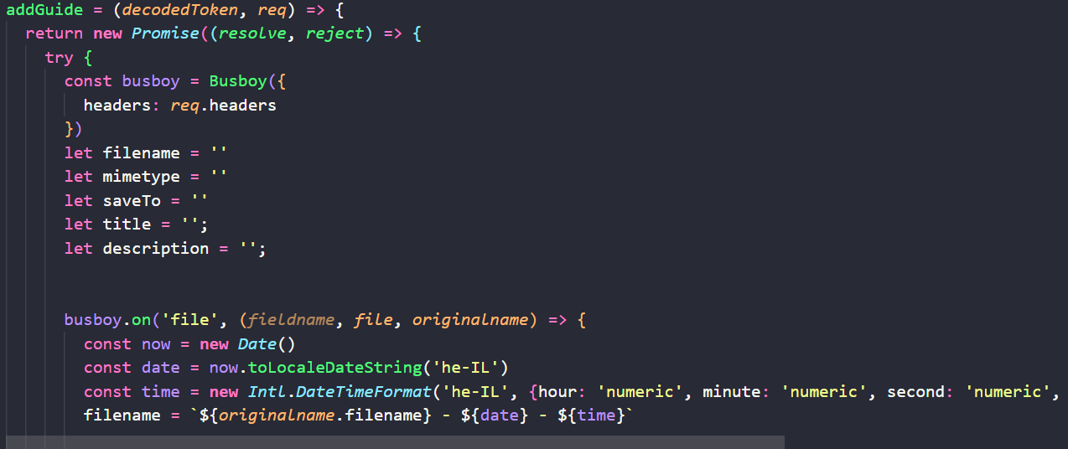
Main modules - Guides & Missions
Inside the model folder of the manager we added the control over the guides and tasks

Slide 17
Requirements from the specification document
An application is an application for collecting information from a field maintenance person, for the purpose of monitoring the level of routine maintenance.
An identification component will be developed for the users.
The application will have access to location services and the camera of the mobile device.
The application developed by the Mobile app, for the Android operating system.
The system will have a management interface (for "manager" and administrator users) adapted to the windows 10 operating system.
The application will be developed as a Multilanguage application. The default language will be set by the administrator.

Slide 18










Main products - Screenshots
Home page
Login screen
Reset password
Sign up
Guides
User’s information (location, job, company, etc.)
Daily missions
Location’s history(Task)
Users authorization(Admin)
Edit/Add a user
And more…

Slide 19
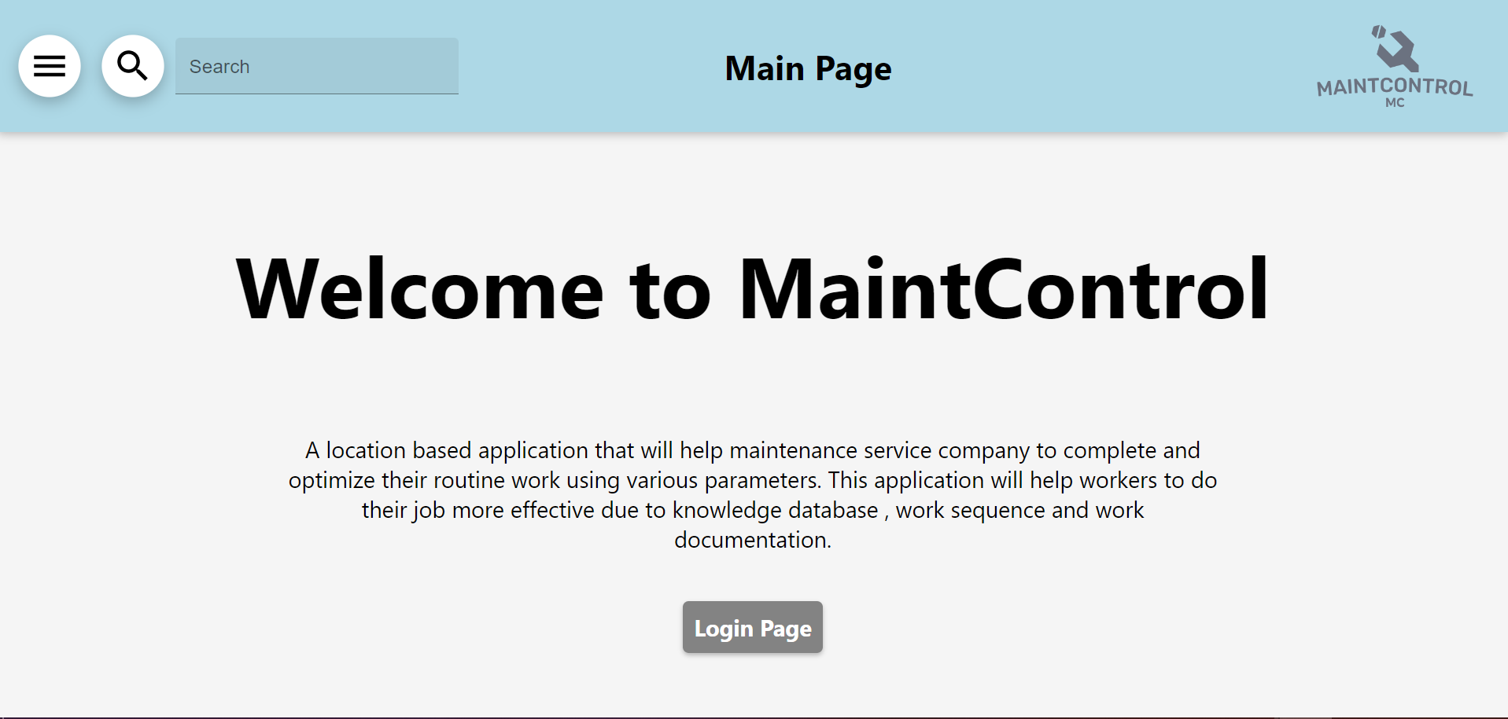
Home Page

Slide 20
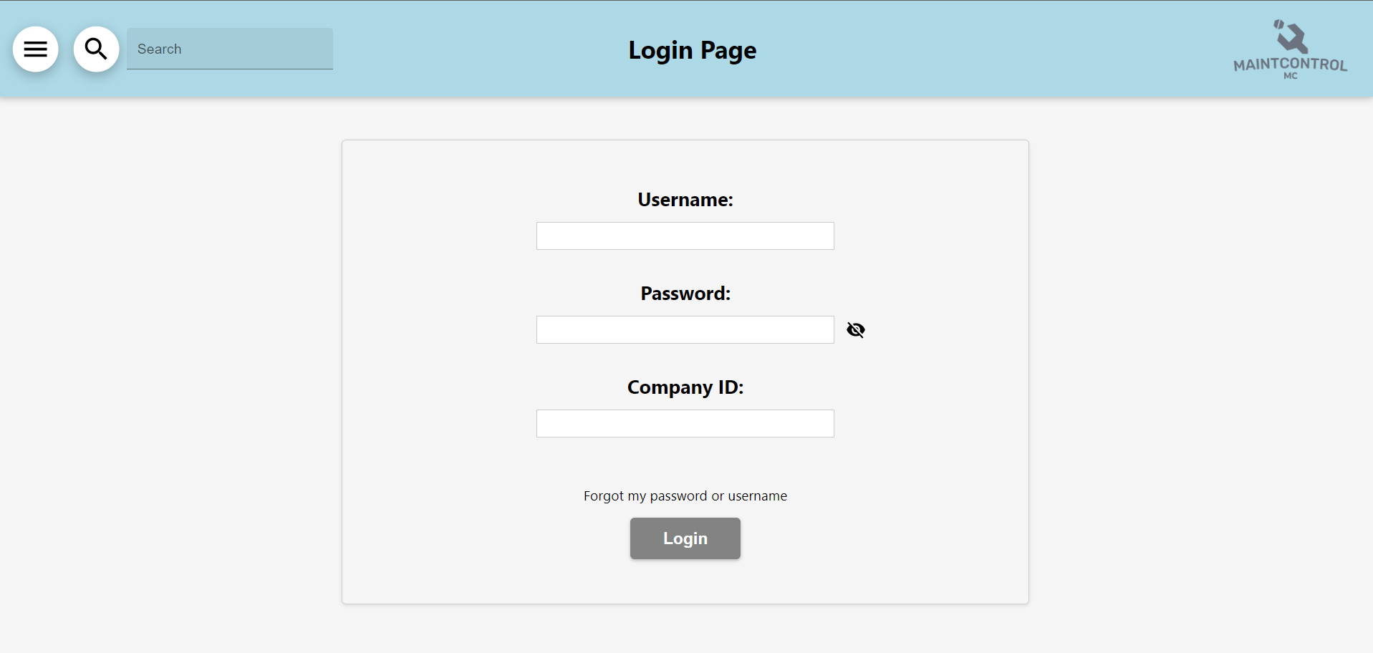
Login Page

Slide 21
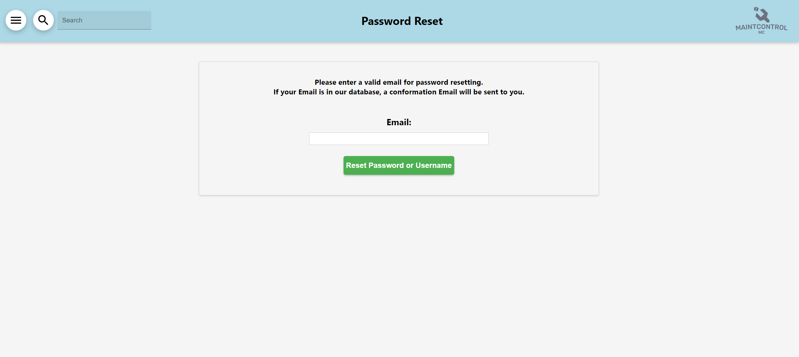
Reset Password Page

Slide 22
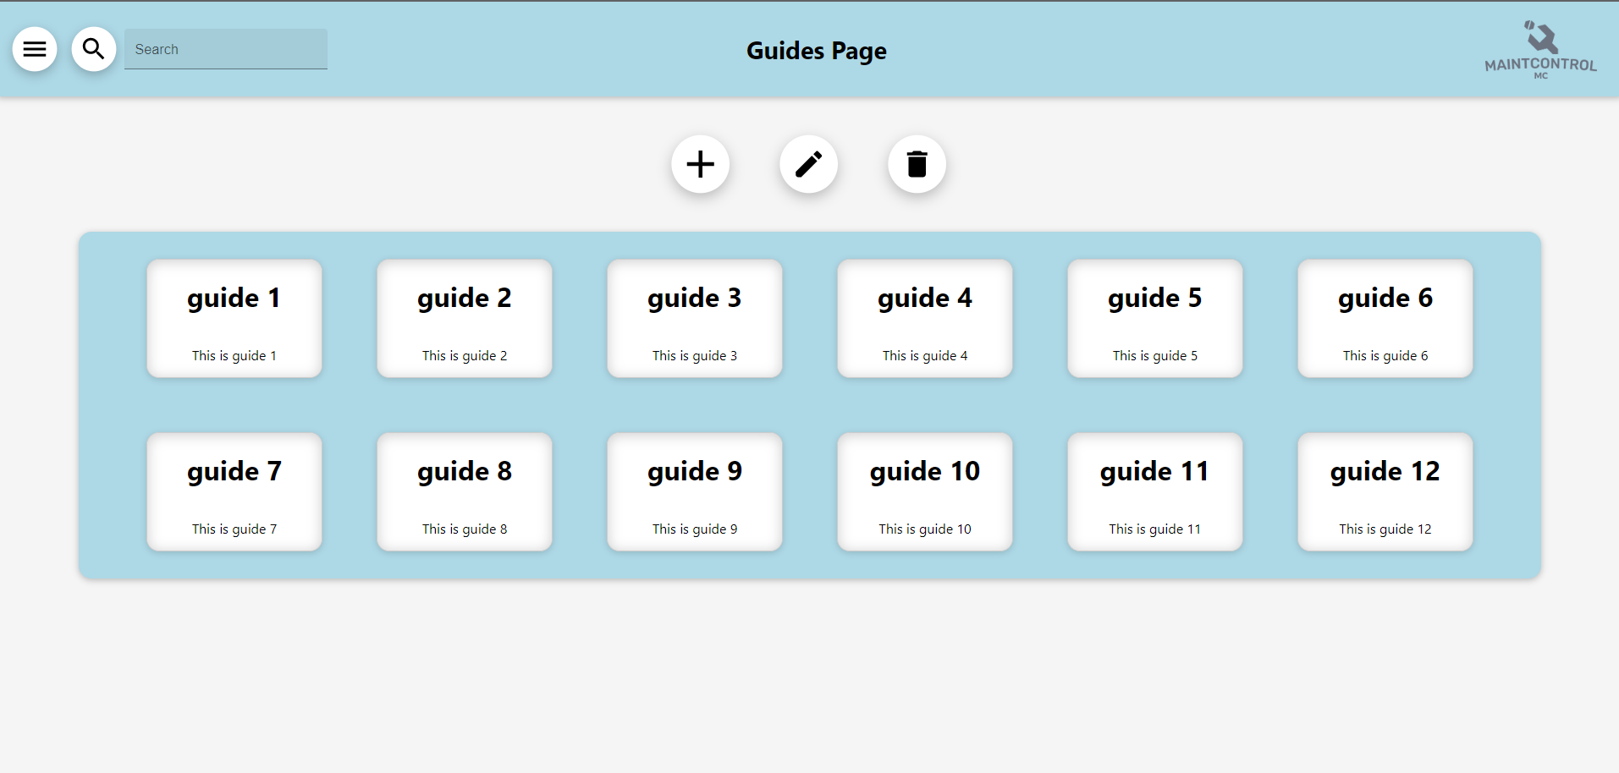
Guides Page

Slide 23
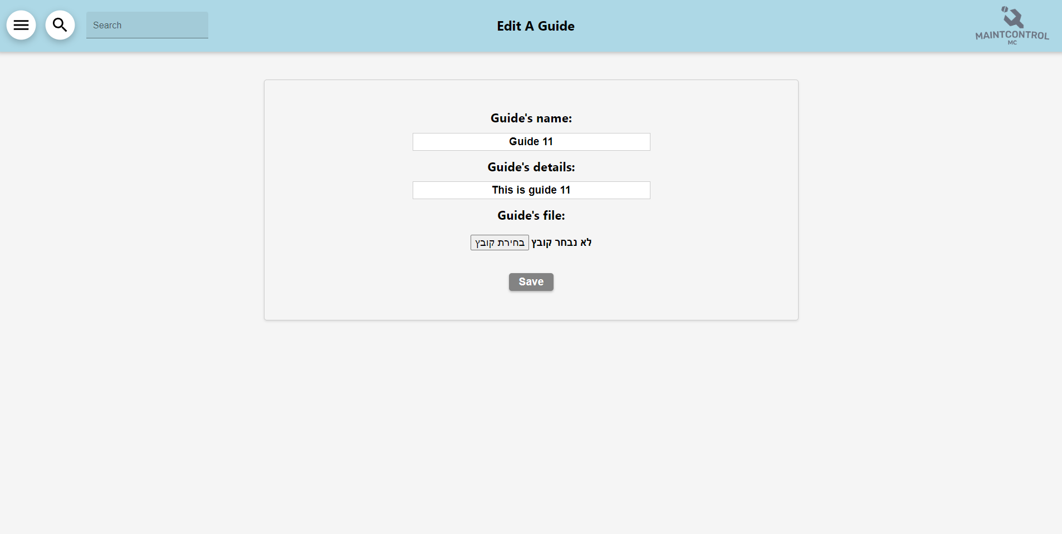
Edit/Add a guide

Slide 24
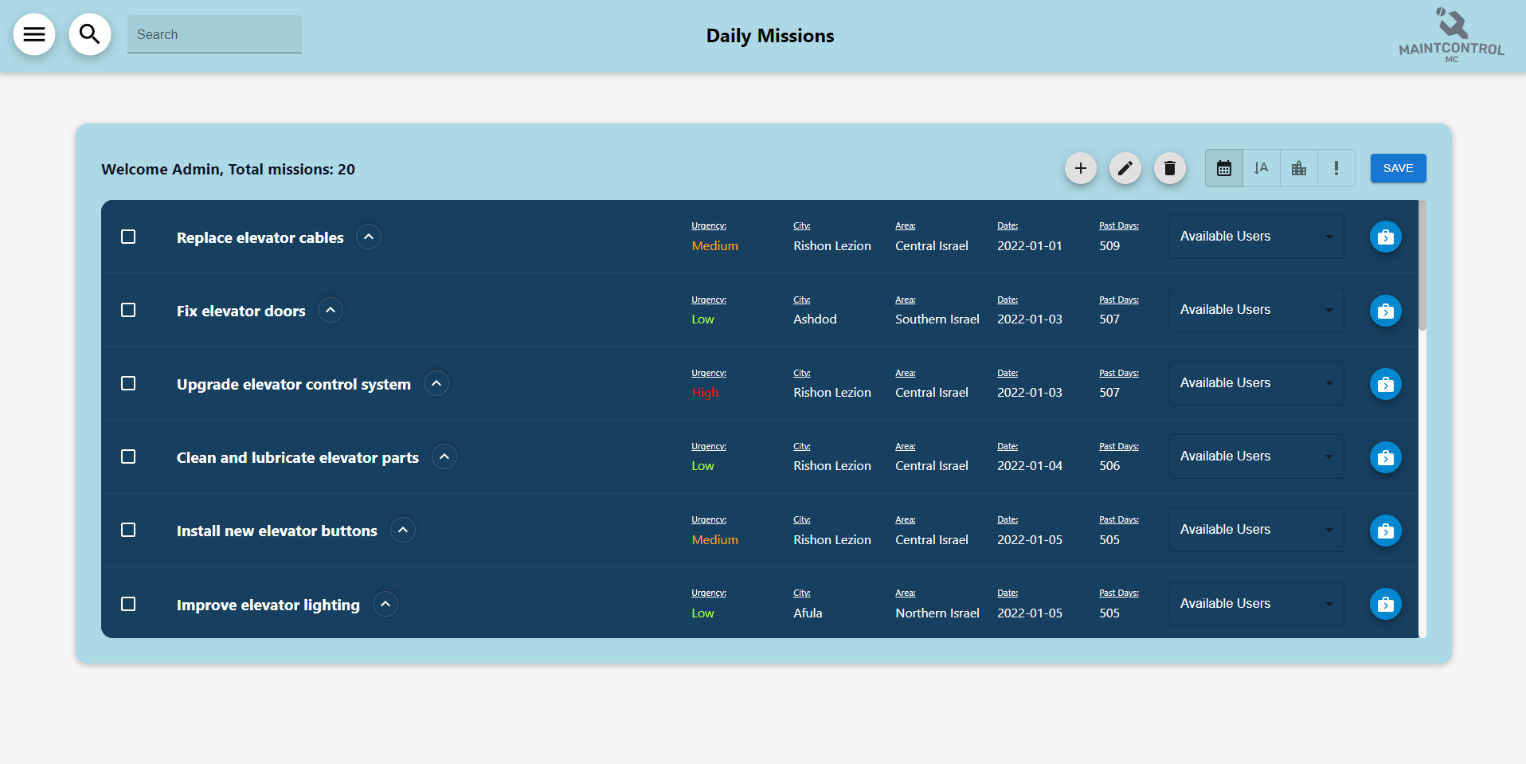
Daily missions
Daily missions

Slide 25
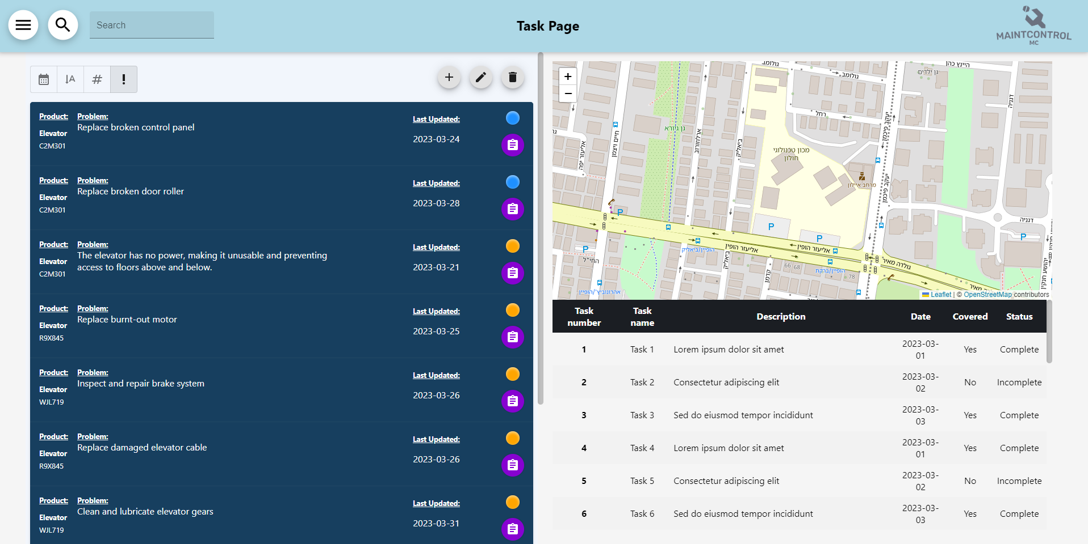
Location’s history (Task page)
Task page

Slide 26
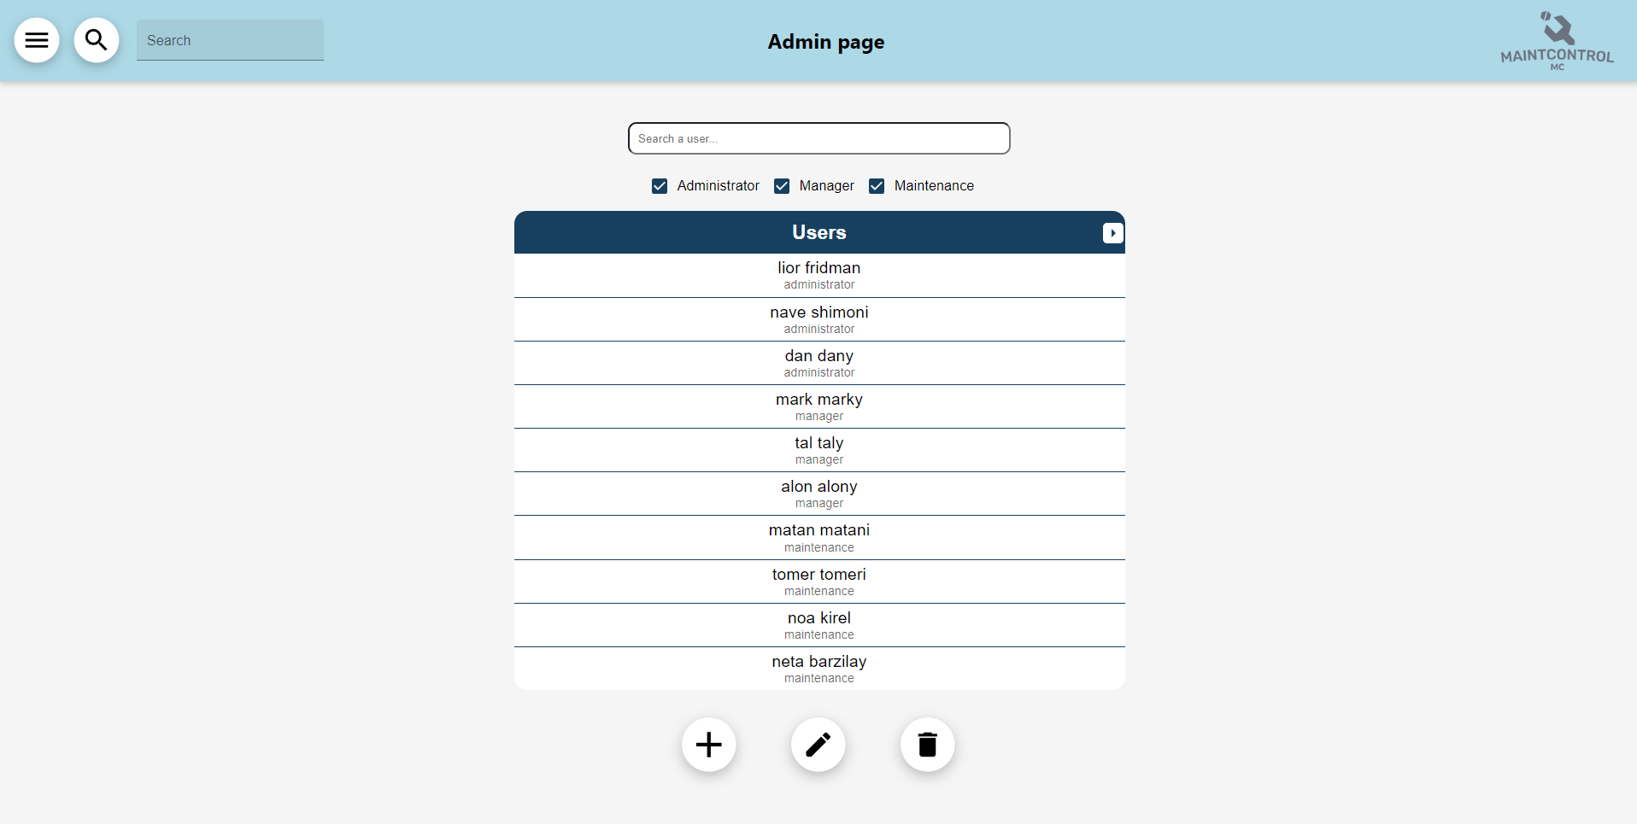
Users authorization (Admin page)

Slide 27
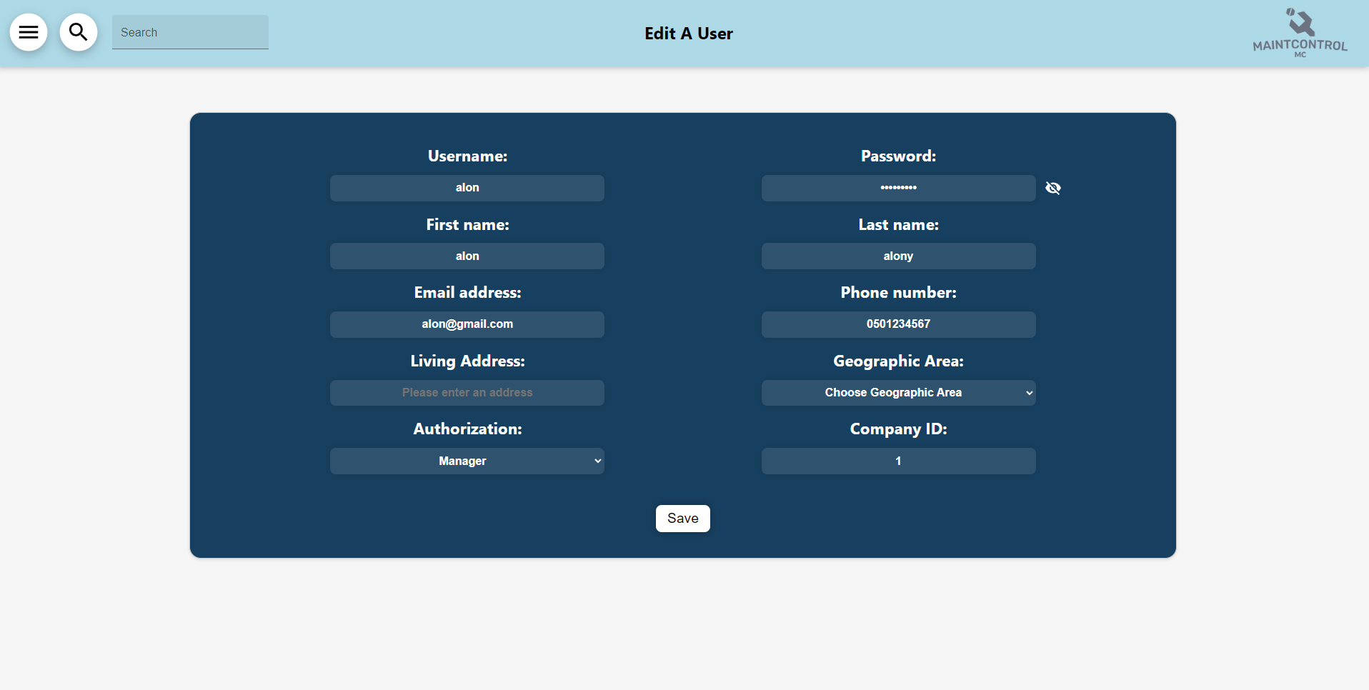
Edit/Add a user
Edit/Add a user

Slide 28
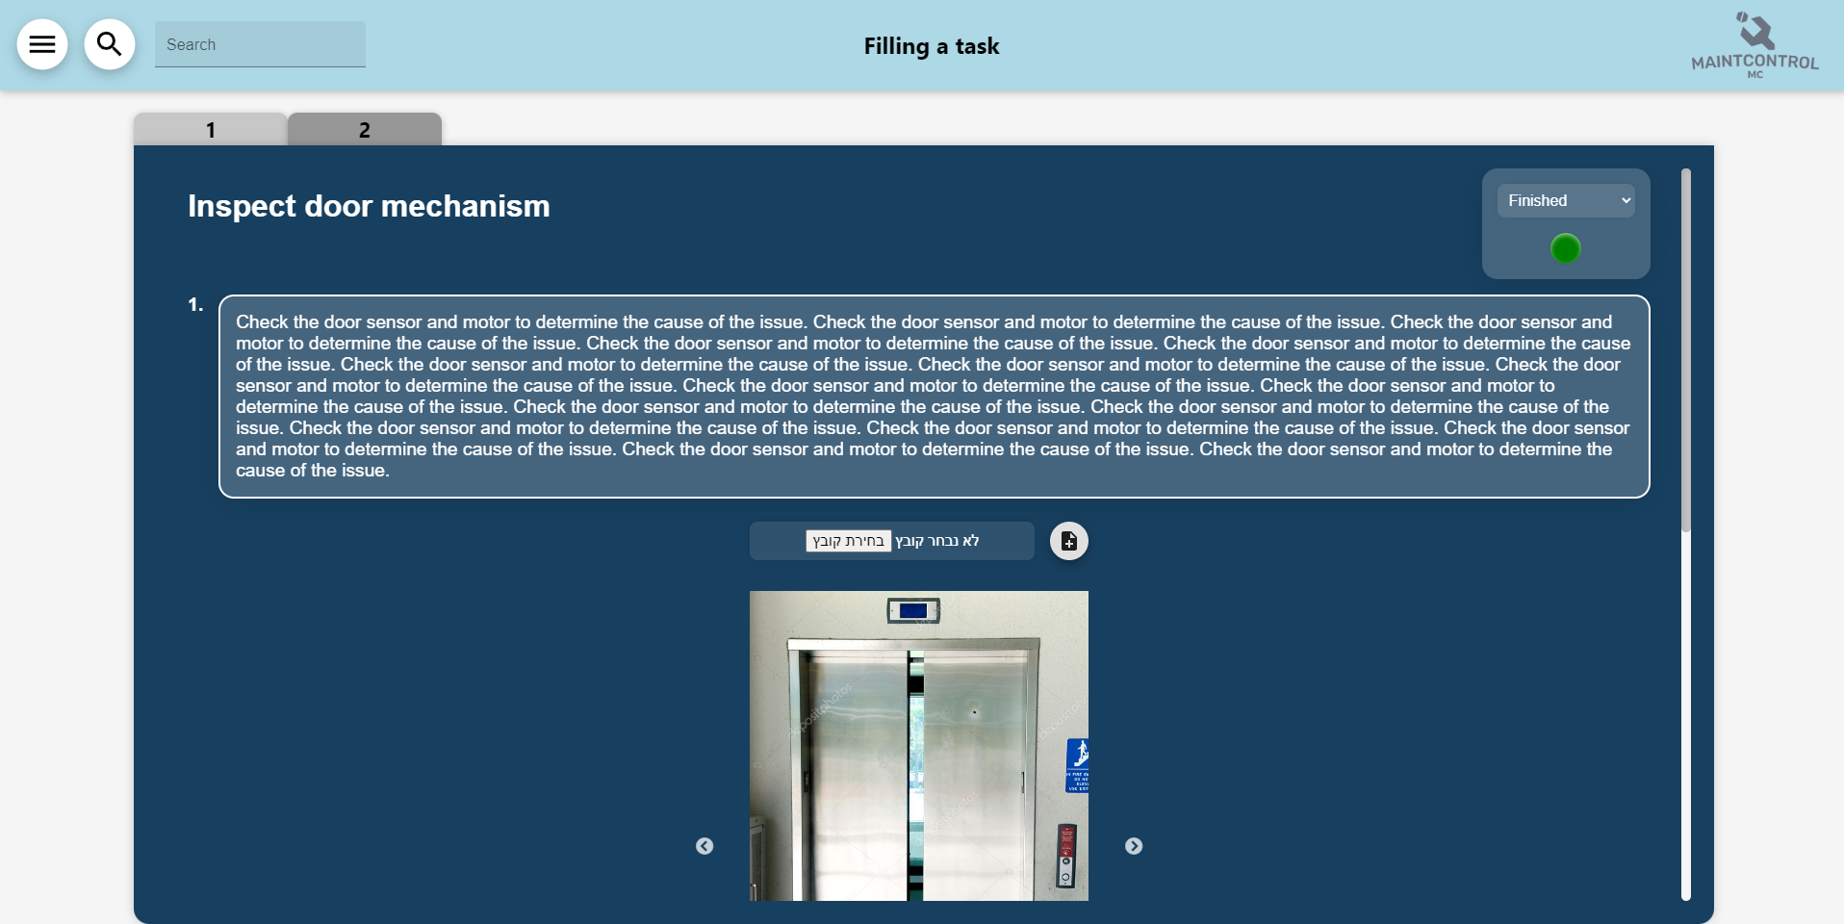
Filling a task
Filling a task

Slide 29
Unexpected problems
Unexpected problems that appeared during the implementation of the project
The creation of the database presented a learning curve for the team. Migrating from a local database to a cloud database using Google Cloud proved to be particularly challenging.
Understanding the Statement of Work (SOW) while simultaneously inventing and developing the app posed a significant hurdle.
Adapting the app for mobile users, considering its initial design for desktop users only, required additional effort and adjustments.
Synchronizing our database with the databases of other teams involved in the project. This required careful coordination and collaboration to ensure data consistency and integrity.
The need to expand and enhance our MySQL database by incorporating additional tables to accommodate the evolving requirements of the project.
Close collaboration with other teams was necessary as they were simultaneously working on code related to the mapping pages, which required effective communication and integration efforts.

Slide 30
Coping and Solving
Database creation and migration to Google Cloud: Invest time in learning the necessary concepts and best practices for database creation and management. Seek guidance from experts or consult relevant documentation and tutorials. Break down the migration process into smaller, manageable tasks and tackle them incrementally. Conduct thorough testing and verification to ensure data integrity after migration.
Understanding the Statement of Work (SOW) while developing the app: Collaborate closely with the project stakeholders to clarify any ambiguities in the SOW. Hold regular meetings or discussions to align the understanding of project requirements. Continuously update and refine the SOW as the development progresses to reflect any changes or new insights.
Adapting the app for mobile users: Conduct a thorough analysis of mobile user requirements and expectations. Redesign and optimize the user interface to be responsive and mobile-friendly. Implement responsive design techniques and frameworks to ensure seamless user experience across different devices. Test the app on various mobile devices and conduct user feedback sessions for further refinements.

Slide 31
Coping and Solving
Synchronizing databases with other teams: Establish clear communication channels with the other teams to discuss and align on database synchronization requirements. Define and implement a synchronization mechanism, such as data exchange protocols or APIs, to ensure consistency between databases. Conduct regular meetings or checkpoints to address any synchronization issues and perform necessary adjustments or updates.
Expanding and enhancing the MySQL database: Analyze the evolving project requirements and identify specific additions or modifications required in the database schema. Plan and implement the necessary changes, ensuring proper data migration and integrity. Test the expanded database thoroughly to validate its functionality and performance.
Collaboration with other teams working on mapping pages: Establish a clear communication channel with the other teams to facilitate collaboration and code integration. Share code repositories or version control systems to manage code changes effectively. Conduct regular code reviews and integration testing to identify and resolve any conflicts or issues. Maintain open and continuous communication to ensure alignment and coordination among teams.

Slide 32
Conclusions for further development
Continue working with Google Cloud - very convenient and easy to learn.
Emphasis on the distribution of powers to each student.
Setting clear schedules and following them.
Setting up separate development and production environments ahead of time is crucial for improving the coding and testing process of the project

